Slide 1


Social Buzz
Notes:
📸

Slide 2


Today's agenda
Project recap
The Analytics team
Process
Insights
Summary

Slide 3

-
Company Overview: Social Buzz, a rapidly growing social media platform, prioritizes content over user identities by keeping users anonymous. The content types include text, images, videos, and GIFs.
Objective: Identify the top 5 content categories by aggregate popularity.
Project Recap

Slide 4



Andrew Fleming Chief Technical Architect
The Analytics team
Marcus Rompton Senior Principal
Myself Data Analyst

Slide 5
Process
1
Data Preparation Imported and combined three Excel sheets: reactions, reaction type, and content type.
2
Data Cleaning Removed duplicates and blank rows to ensure data accuracy and consistency.
3
Data Integration Used VLOOKUP to link content type, category, sentiment and score to the ‘Reactions’ sheet.
4
Data Aggregation Summed up the reaction scores for each content category.
5
Top Content Categories Identification Identified the top 5 content categories based on aggregate reaction scores.

Slide 6

Insights
16 Unique Categories
1897 Total Reactions to “Animal” Posts
January Month with most posts

Slide 7
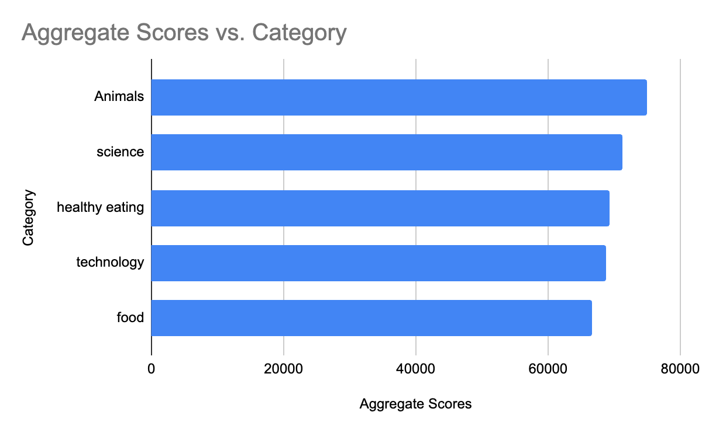

Slide 8
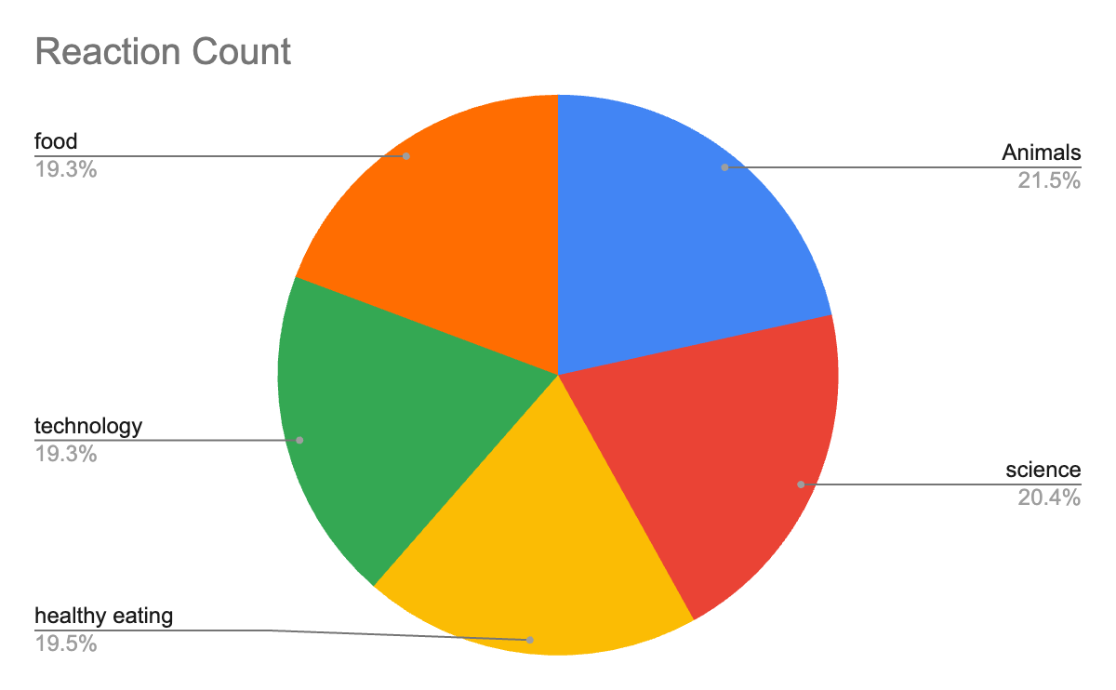

Slide 9

Diverse User Engagement: Social Buzz users engage deeply with a wide array of topics such as animals, science, healthy eating, technology, and food, indicating a diverse audience with varied interests.
Summary
Focus on High-Engagement Categories: Allocate resources to enhance content quality and frequency in the top 5 categories identified (animals, science, healthy eating, technology, and food) to maximize user interaction and retention.
Strategic Content Alignment: Tailor marketing efforts and partnerships to align with the identified user preferences, ensuring that promotional activities resonate effectively with the platform's audience to foster continued growth and user satisfaction.

Slide 10

Thank you!
ANY QUESTIONS?

